Slide 1

Stack

Slide 2

Stack
stack is an ordered collection of homogeneous data elements where the insertion and deletion operations take place at one end only.
insertion and 'deletion operations in the case of a stack are specially termed PUSH and POP,respectively, and the position of the stack where these operations are performed is known as the TOP of the stack.
element in a stack is termed an ITEM. The maximum number of elements that a stack can accommodate is termed SIZE.
stack is also called Last-In-First-Out (LIFO) type of list or First in Last Out(FILO)
Linear data structure
Abstract Datatype

Slide 3
Stack
Common model of a stack is plates in a marriage party. Fresh plates are “pushed”
onto the top and “popped” off the top. • Some of you may eat biscuits. If you assume only one side of the cover is torn and biscuits are taken off one by one. This is called popping and similarly, if you want to preserve some biscuits for some time later, you will put them back into the pack through the same torn end called pushing.

Slide 4
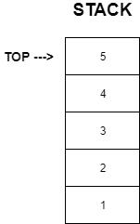
Stack

Slide 5
OPERATIONS ON STACK
Basic operations that can be performed on stack are as follows : 1. PUSH : The process of adding a new element to the top of the stack is called PUSH operation. Pushing an element in the stack involve adding of element, as the new element will be inserted at the top, so after every push operation, the top is incremented by one. In case the array is full and no new element can be accommodated, it is called STACK-FULL condition. This condition is called STACK OVERFLOW. 2. POP : The process of deleting an element from the top of the stack is called POP operation. After every pop operation, the stack is decremented by one. If there is no element on the stack and the pop is performed then this will result into STACK UNDERFLOW

Slide 6
IMPLEMENTATION OF STACKS
Stack can be implemented in two ways : (a) Static implementation (b) Dynamic implementation

Slide 7
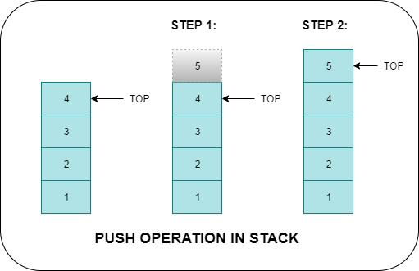
Push operation

Slide 8
Static implementation-Using Array
Algorithm for PUSH Operation
Start
Declare item
Check whether if Top= size-1, then go to step4 else go to step 5
Print Stack overflow. Insertion cannot be done go to step 8
Read the element to be inserted as item
Set Top=Top+1
Set Stack[Top]=item
Stop

Slide 9
Static implementation-Using Array
void push()
{
int item;
If(Top=Max-1) {
printf(“Stack Overflow insertion cannot be done”) ;}
else{
printf (“enter element to be inserted”) ;
scanf (“%d”, &item) ;
Top=Top+1;
Stack[Top]=item;}}

Slide 10
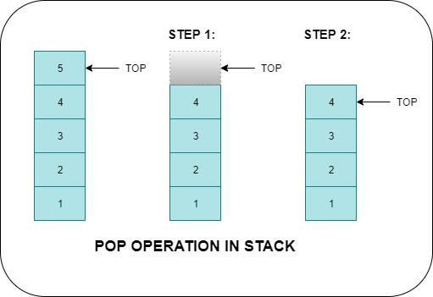
Pop

Slide 11
Static implementation-Using Array
Algorithm for POP Operation
Start
Declare item
Check whether if Top= -1, then go to step3 else go to step 4
Print Stack underflow. Deletion cannot be done go to step 7
Set item=Stack[Top]
Set Top=Top-1
Print the deleted item as item
Stop

Slide 12
Static implementation-Using Array
void pop()
{
int item;
If(Top==-1) {
printf (“stack underflow. Deletion cannot be possible “) ;}
else{
item=Stack[Top];
Top=Top-1;
printf (“Deleted item is%d”, item) ;}

Slide 13
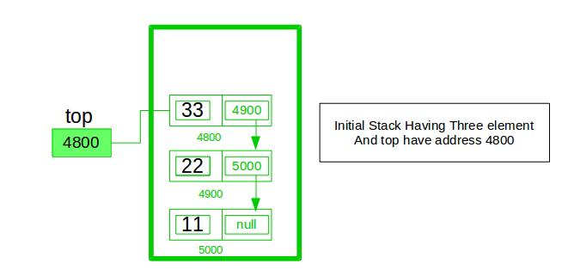
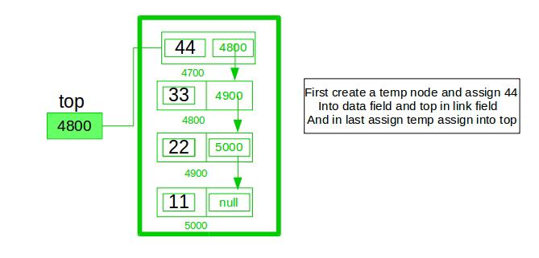

Slide 14
Dynamic implementation-Using Linked List
Algorithm for PUSH()
Start
Declare a structure pointer new
Allocate memory to new
Read the element to be inserted as new->data
Assign new->next as Top
Assign Top as new
Stop

Slide 15
Dynamic implementation-Using Linked List
void push()
{
struct node *new;
new=(struct node*) malloc(sizeof(struct node)) ;
Printf(“enter element to be inserted”) ;
Scanf(“%d”, &new->data) ;
new->next=top;
Top=new;}

Slide 16
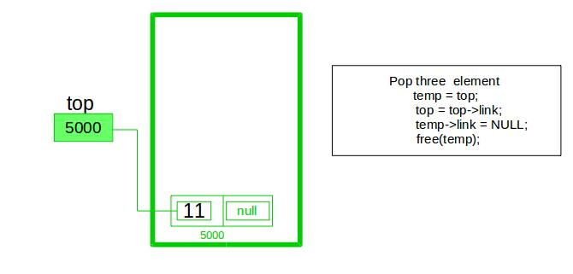

Slide 17
Dynamic implementation-Using Linked List
Start
Declare structure pointer Temp
Check if top==NULL Then print stack underflow and go to step8 else go to Step4
Assign temp as Top
Print temp->data
Assign top as temp>next
Delete temp
Stop

Slide 18
Dynamic implementation-Using Linked List
void pop()
{
struct node *temp;
if(Top==NULL) {
printf(“stack underflow”) ;}
else{
temp=Top;
printf (“deleted item is%d”, temp->data) ;
Top=temp ->next;
Free(temp);}

